Slide 1

Imaging and Analysis of Post-processing for Discrete Element Method and its Application
Algorithm Description & Calculation Example
Numerical Simulation Experiment
Nanjing University
WEI Huajing
04/07/2020

Slide 2
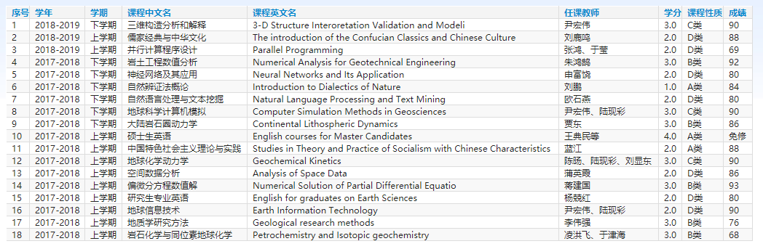
Curriculum
18 courses for 45 credits

Slide 3
Workload
Python Code for Post-processing Algorithm: 56172 lines
2D Compression Structural Experiment: 53 sets
Structural Deformation and Feature Map Figure: 5724 pieces

Slide 4
Outline
Introduction
Algorithm
Example
Experiment
Conclusion

Slide 5
Outline
Introduction
Algorithm
Example
Experiment
Conclusion

Slide 6
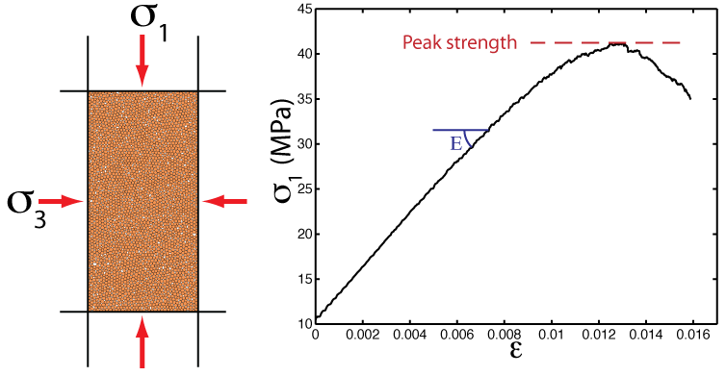
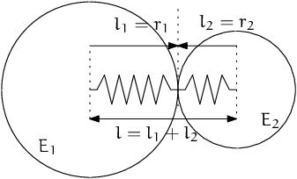
Background
DEM: Discrete Element Model
Micro-granular system for macroscopic object
Based on Newtonian mechanics
Masses of computation

Slide 7
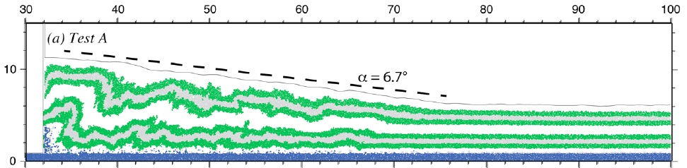
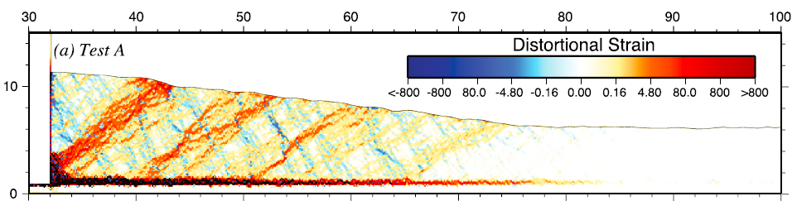
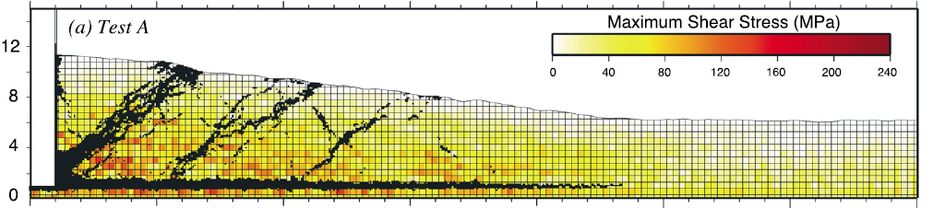
DEM Software

Slide 8
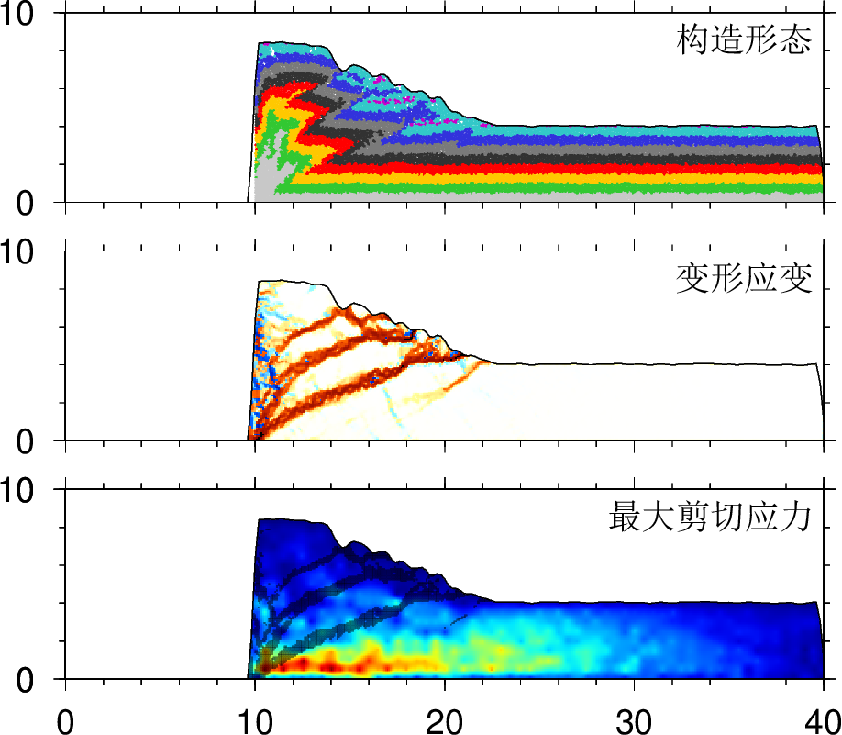
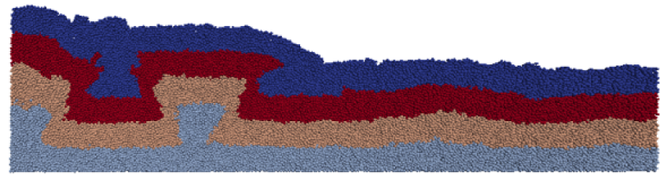
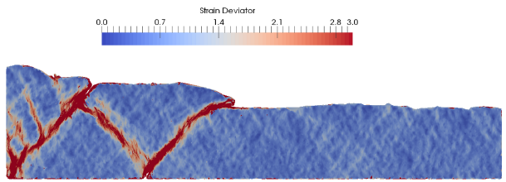
DEM Software

Slide 9
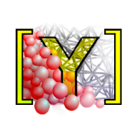
Software
YADE: Yet Another Dynamic Engine
Performed on Linux
Open Source
Python Command Line

Slide 10
Outline
Introduction
Algorithm
Example
Experiment
Conclusion

Slide 11

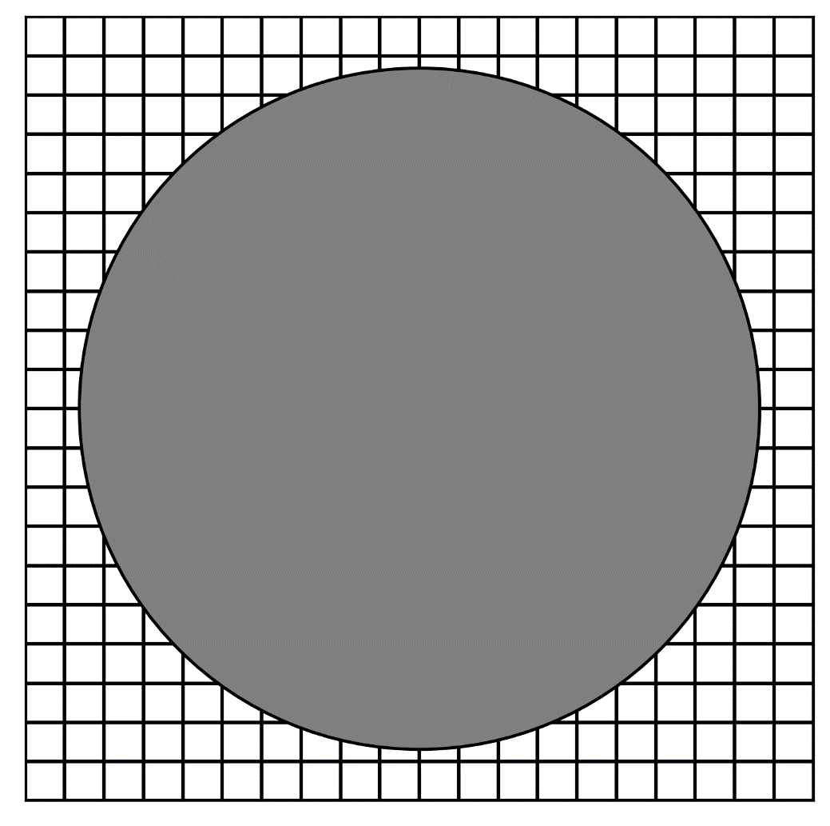
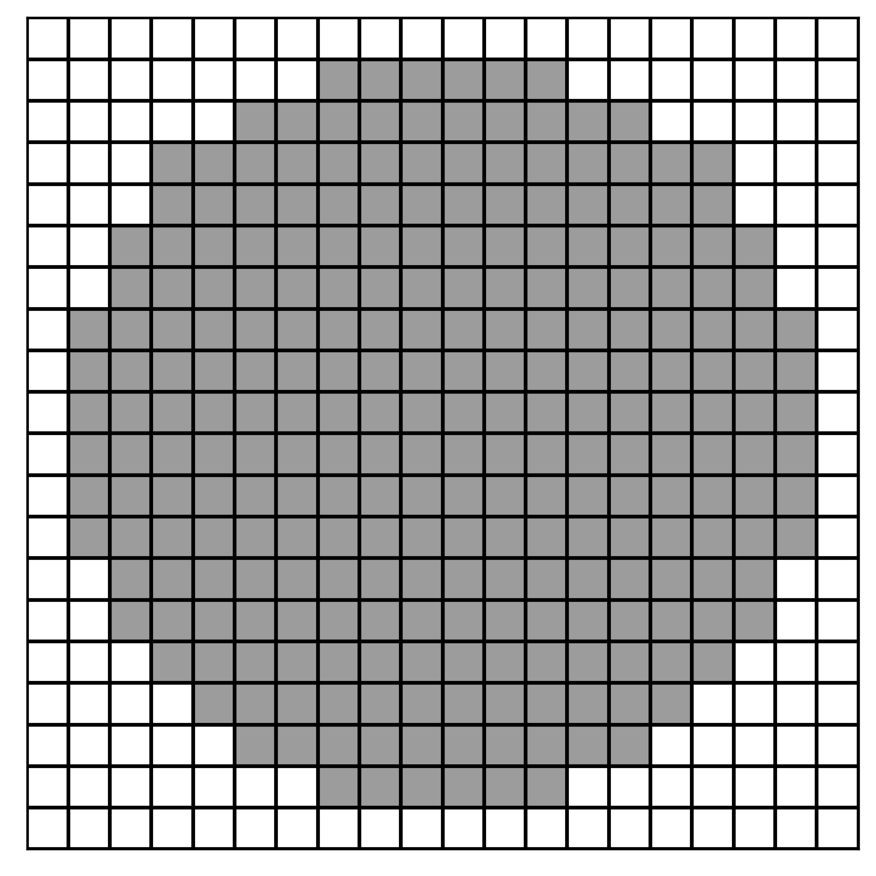


Rasterization
GitHub: https://github.com/jerryweihuajing/Post-Processing

Slide 12
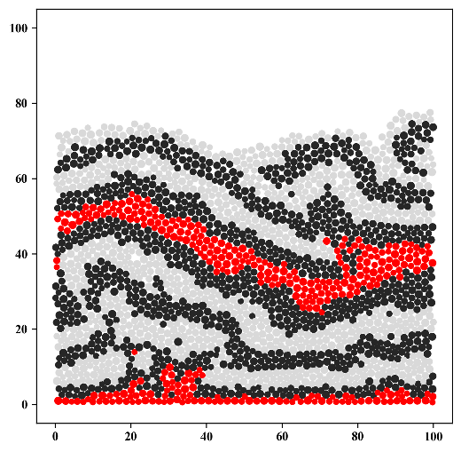
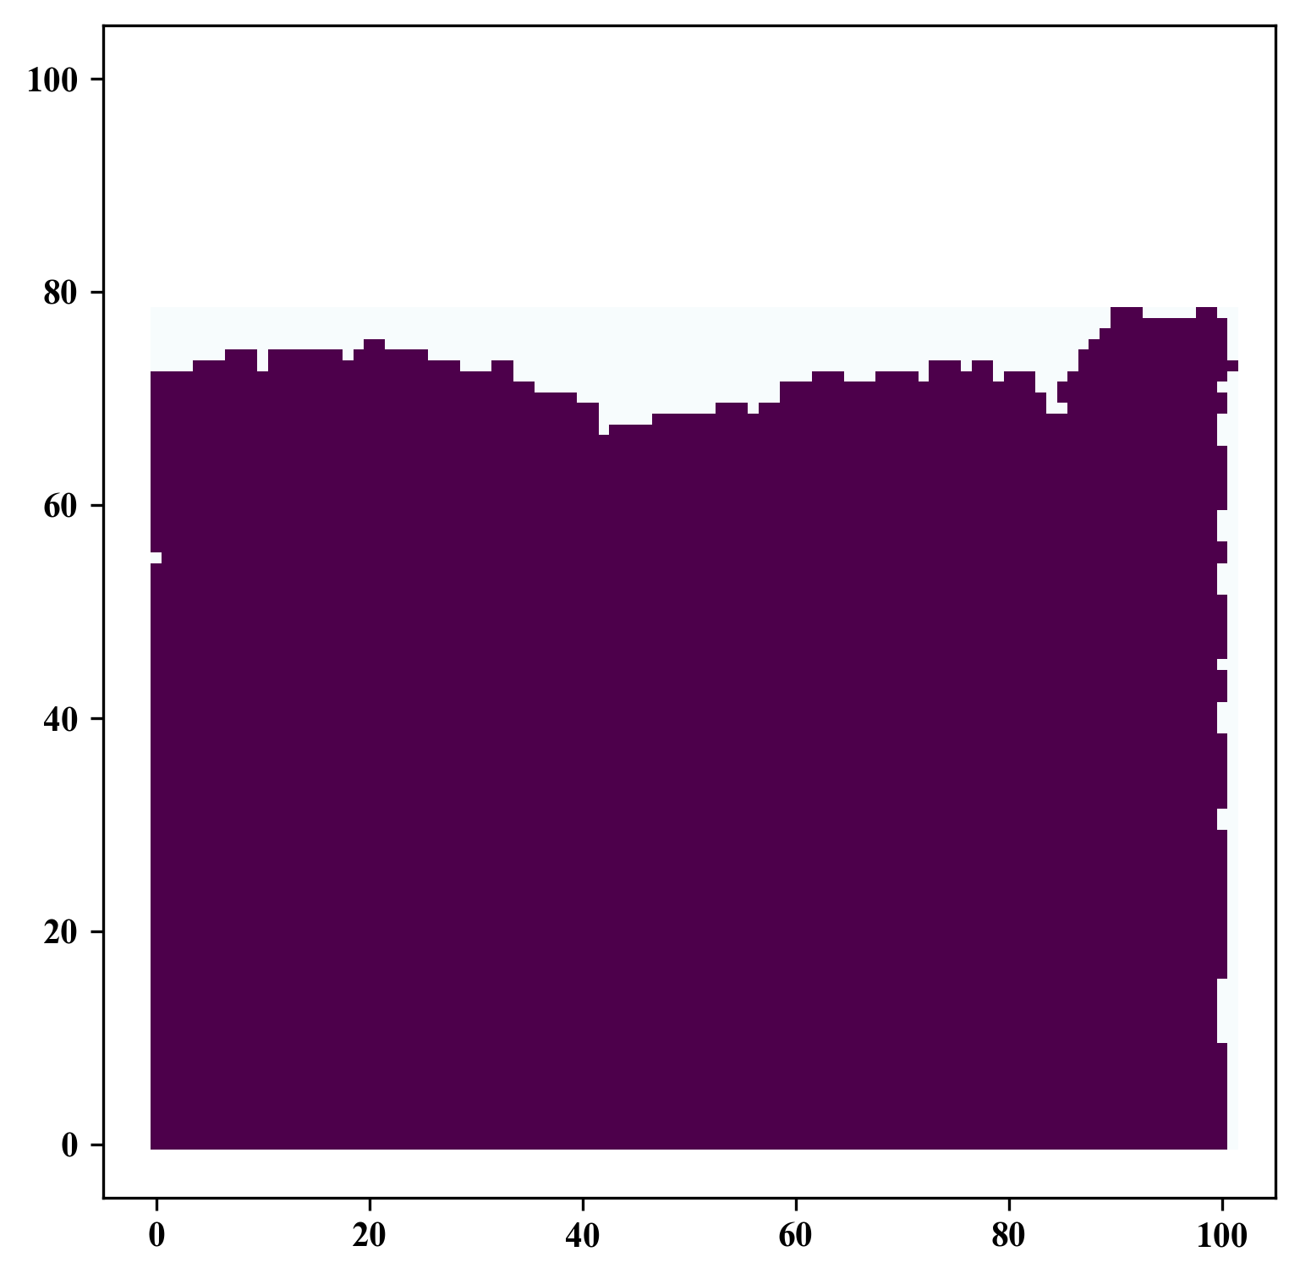
Rasterization
GitHub: https://github.com/jerryweihuajing/Post-Processing

Slide 13
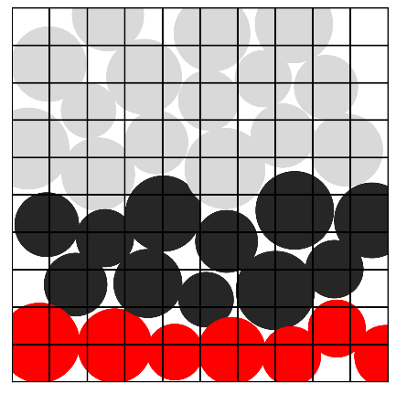
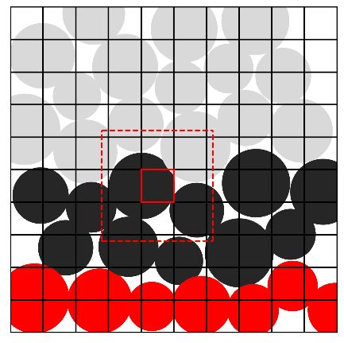
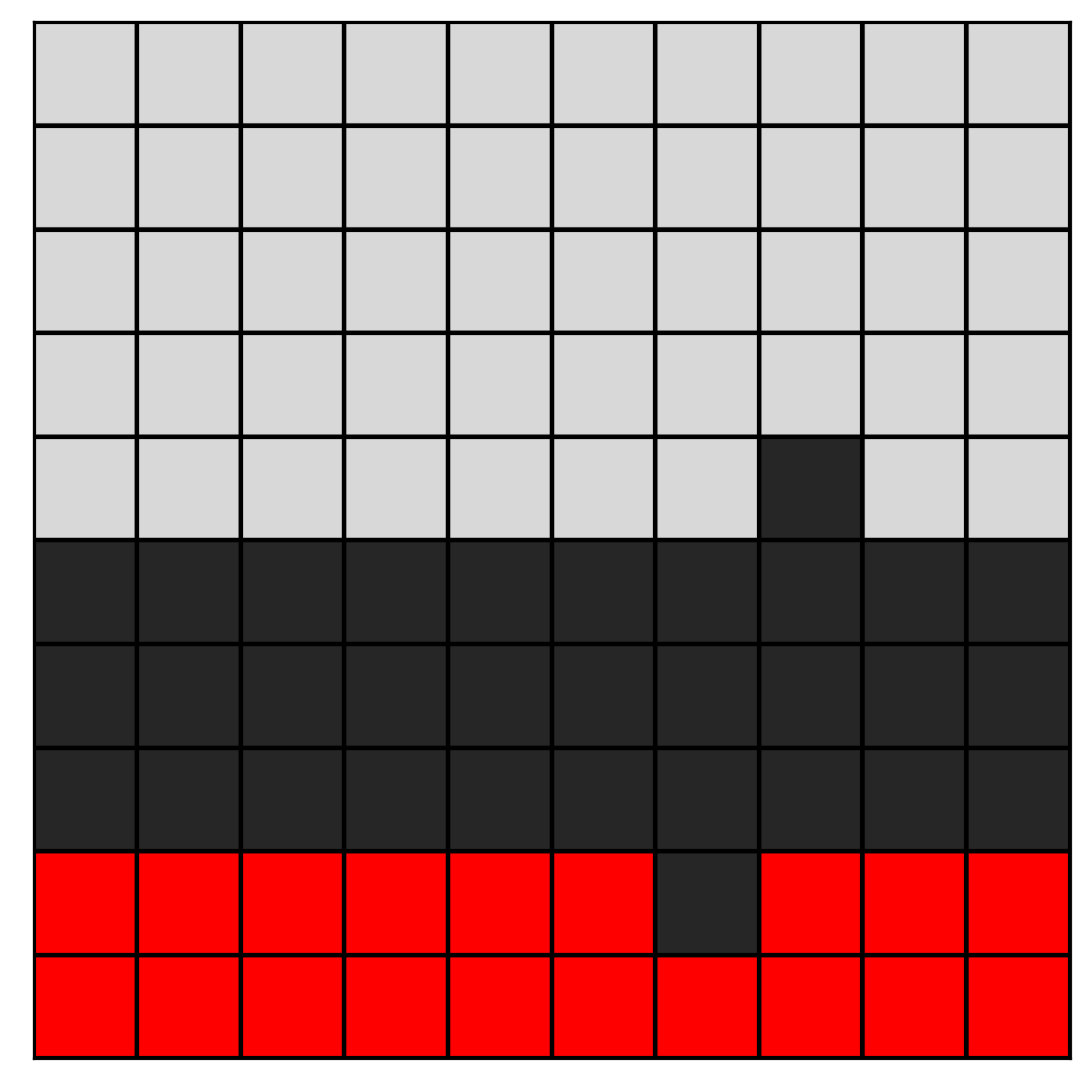
Rasterization
GitHub: https://github.com/jerryweihuajing/Post-Processing

Slide 14

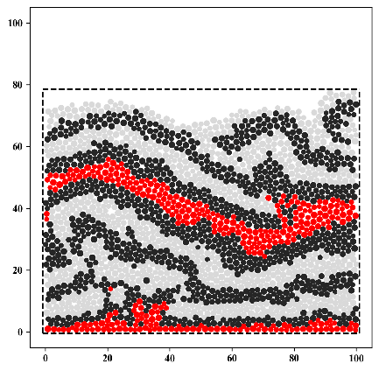
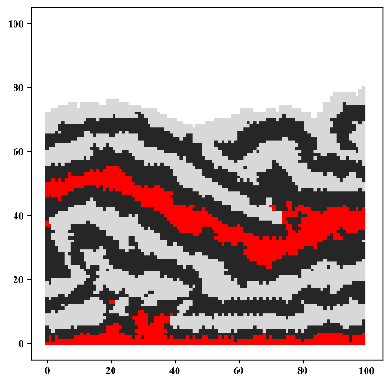
Rasterization
GitHub: https://github.com/jerryweihuajing/Post-Processing

Slide 15
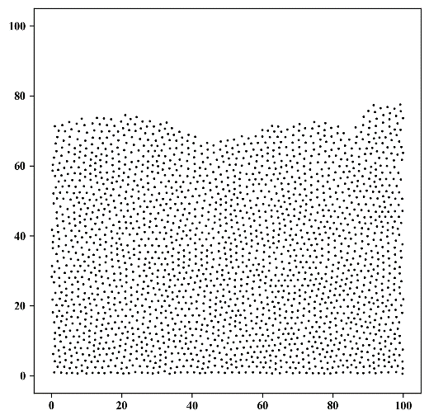
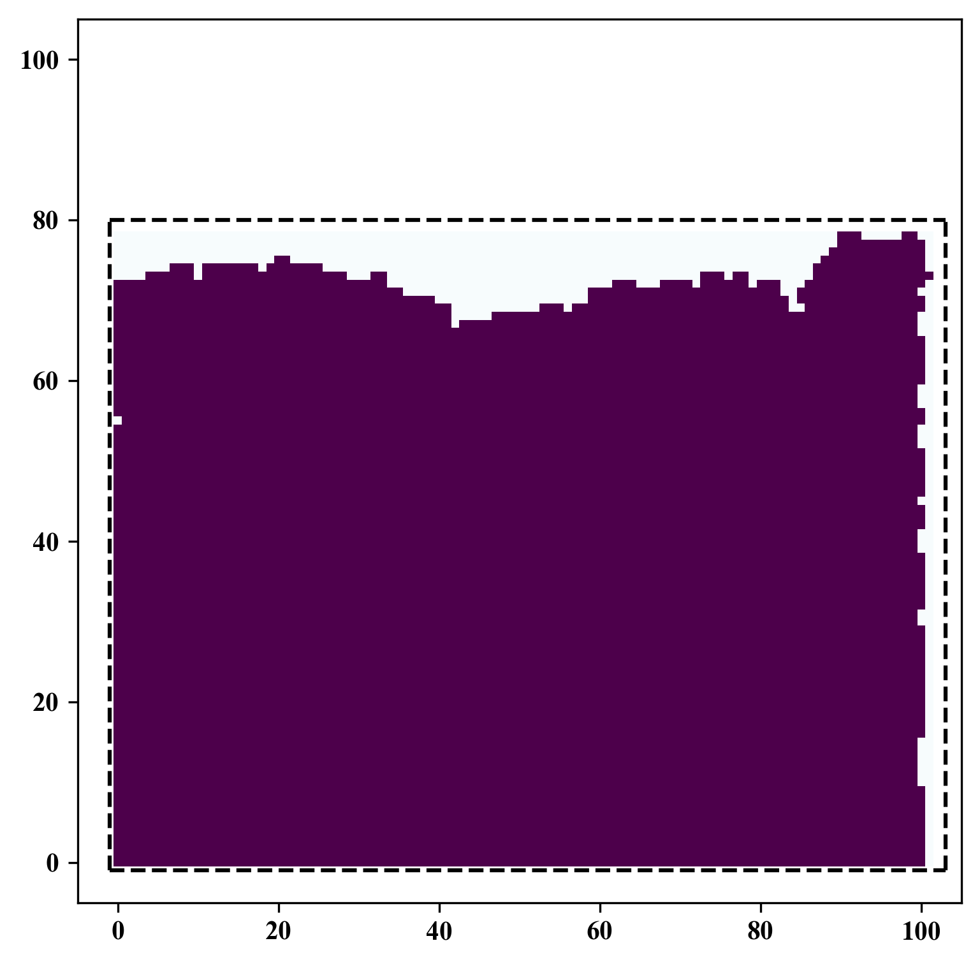
Spatial Interpolation
GitHub: https://github.com/jerryweihuajing/Post-Processing

Slide 16
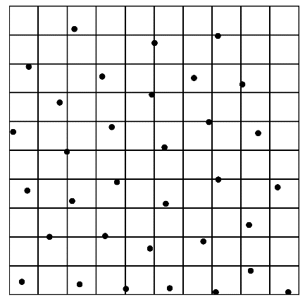
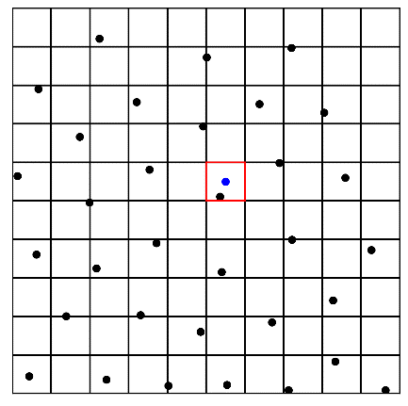
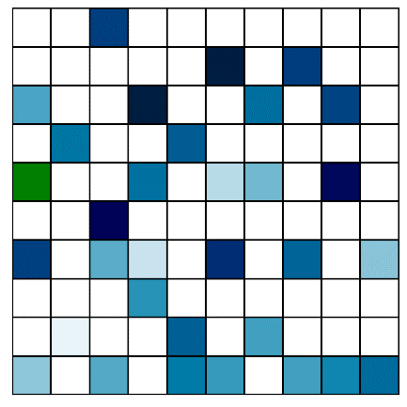
Spatial Interpolation
GitHub: https://github.com/jerryweihuajing/Post-Processing

Slide 17
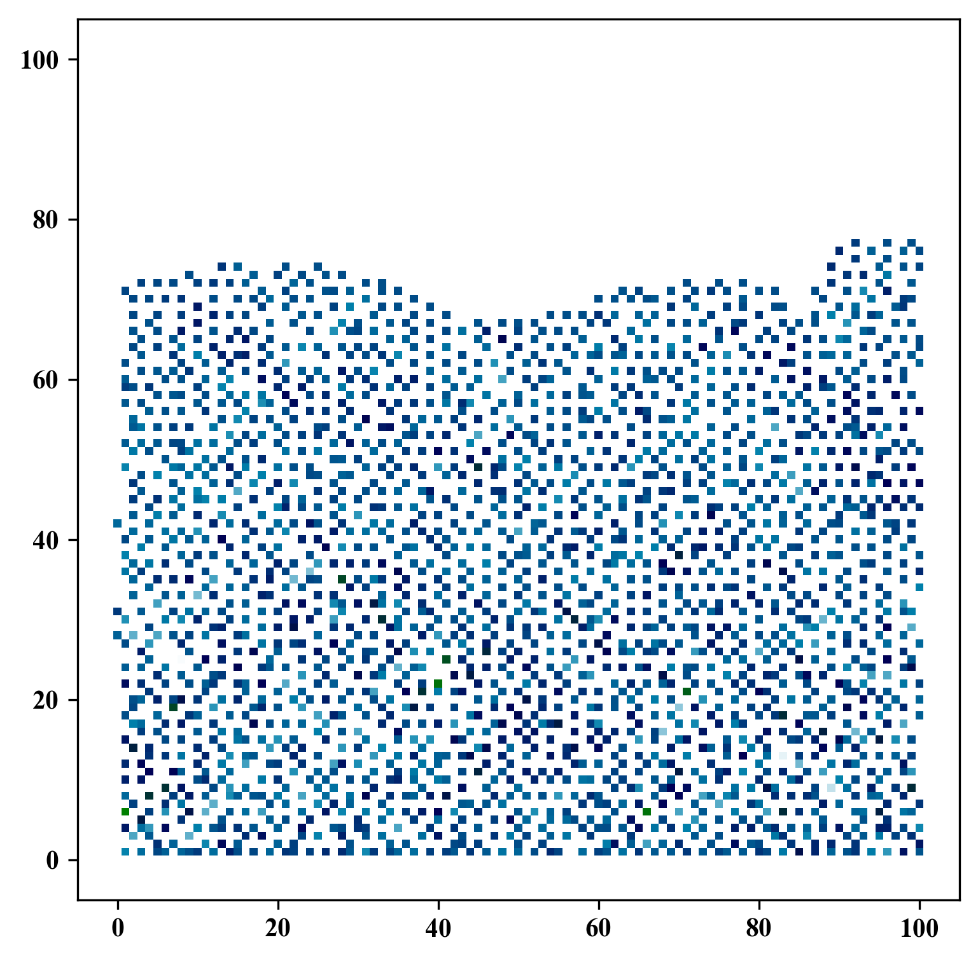
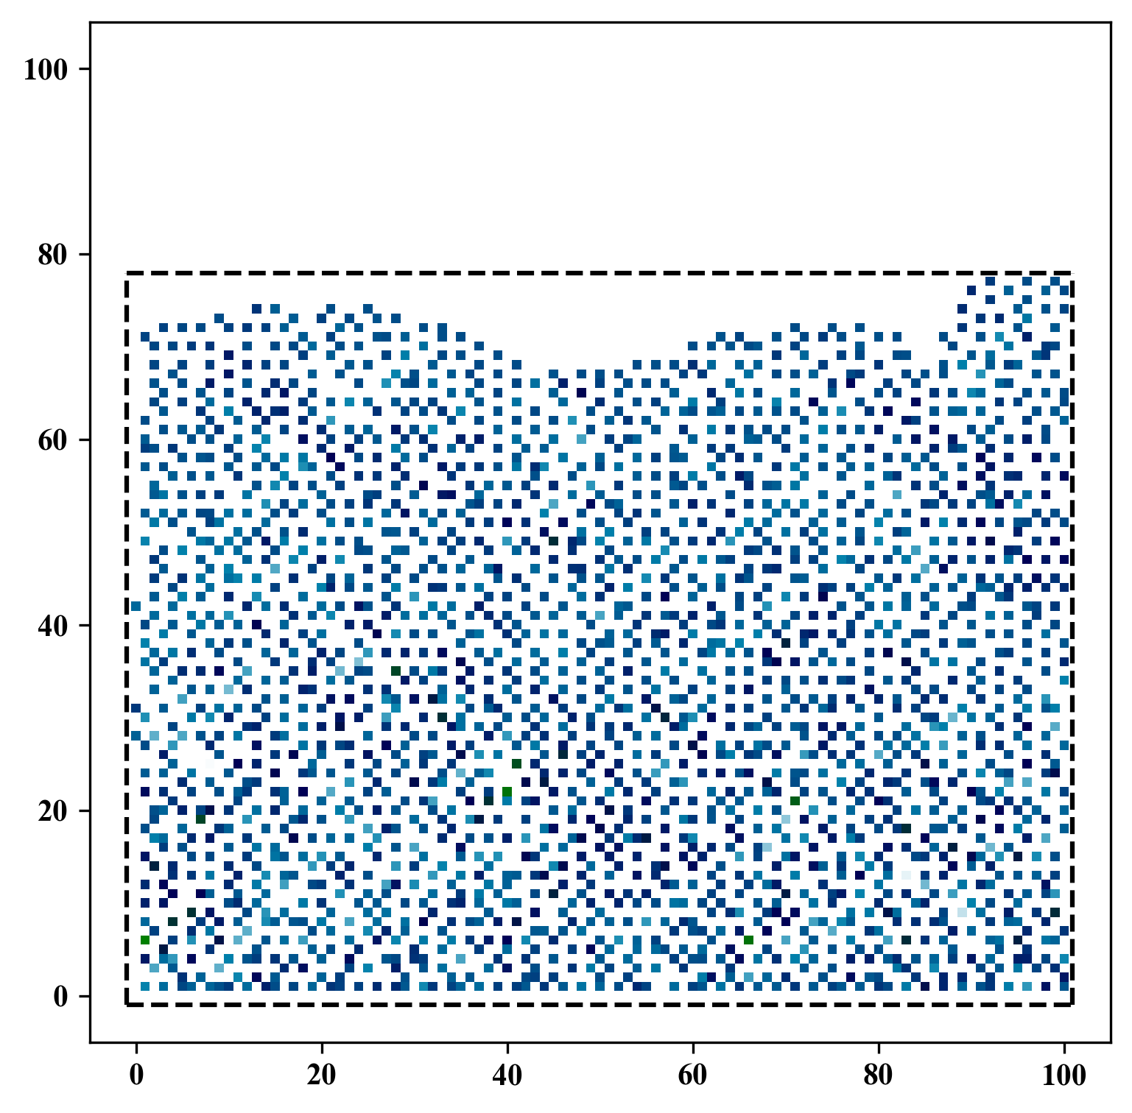
Spatial Interpolation
GitHub: https://github.com/jerryweihuajing/Post-Processing

Slide 18
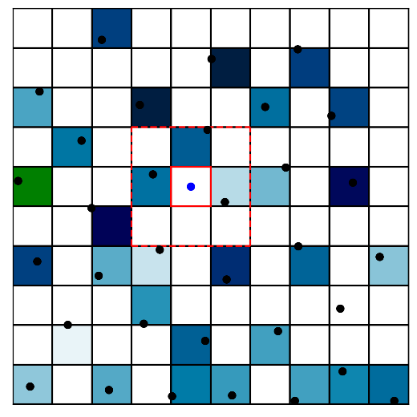
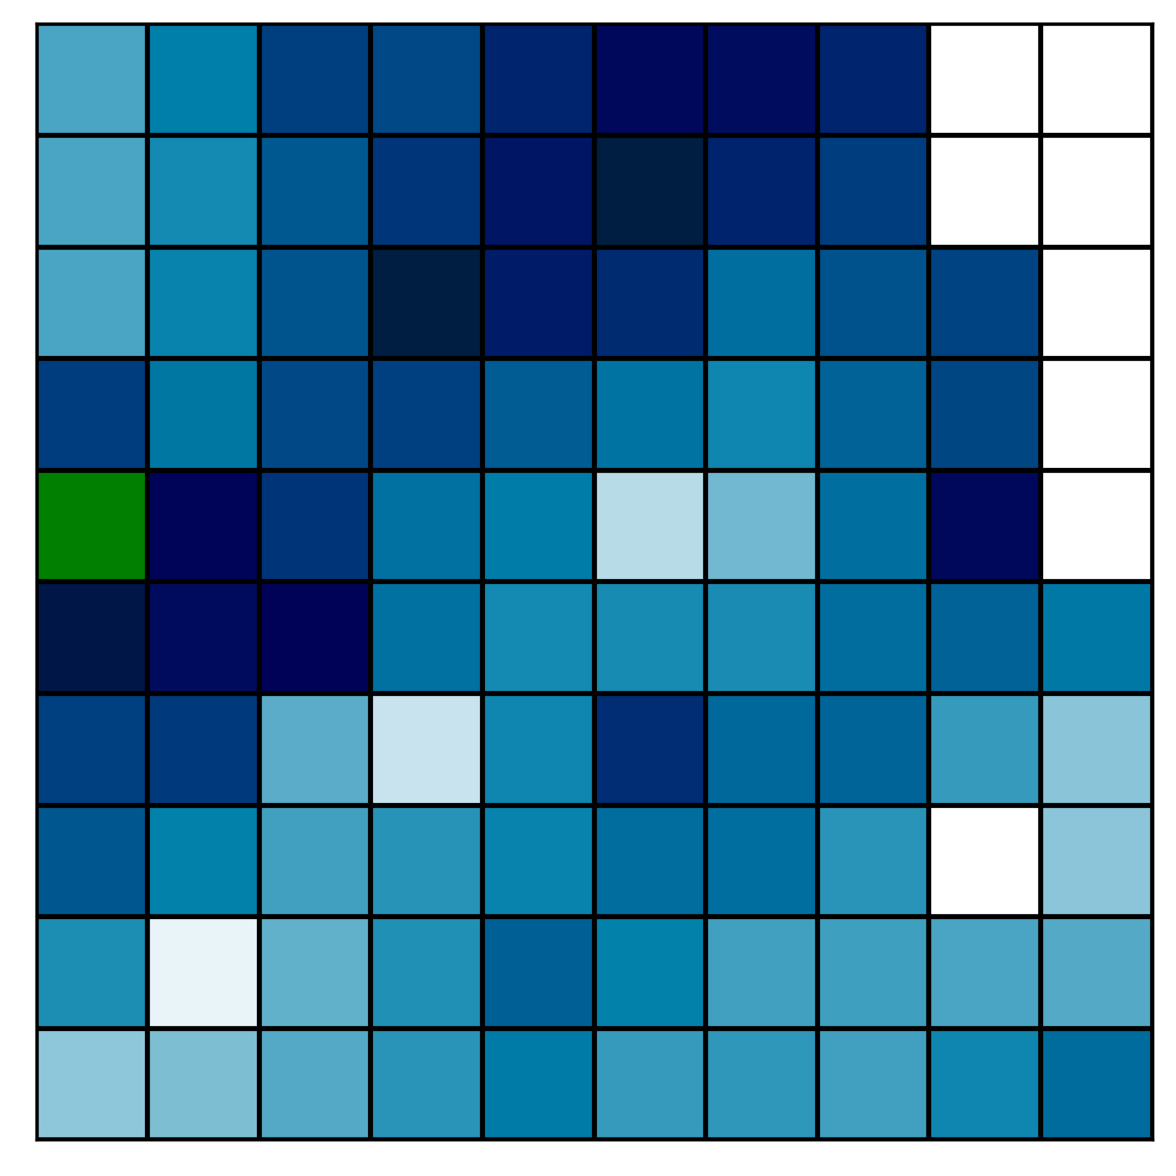
Spatial Interpolation
GitHub: https://github.com/jerryweihuajing/Post-Processing

Slide 19
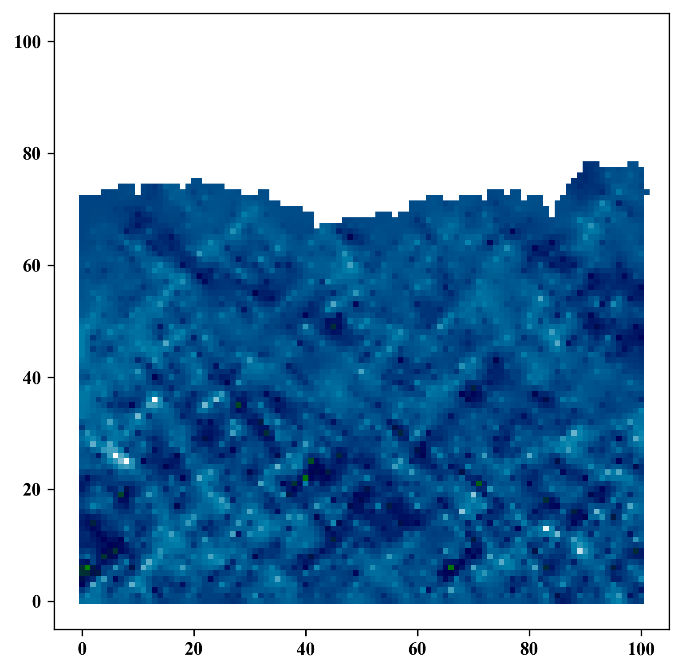
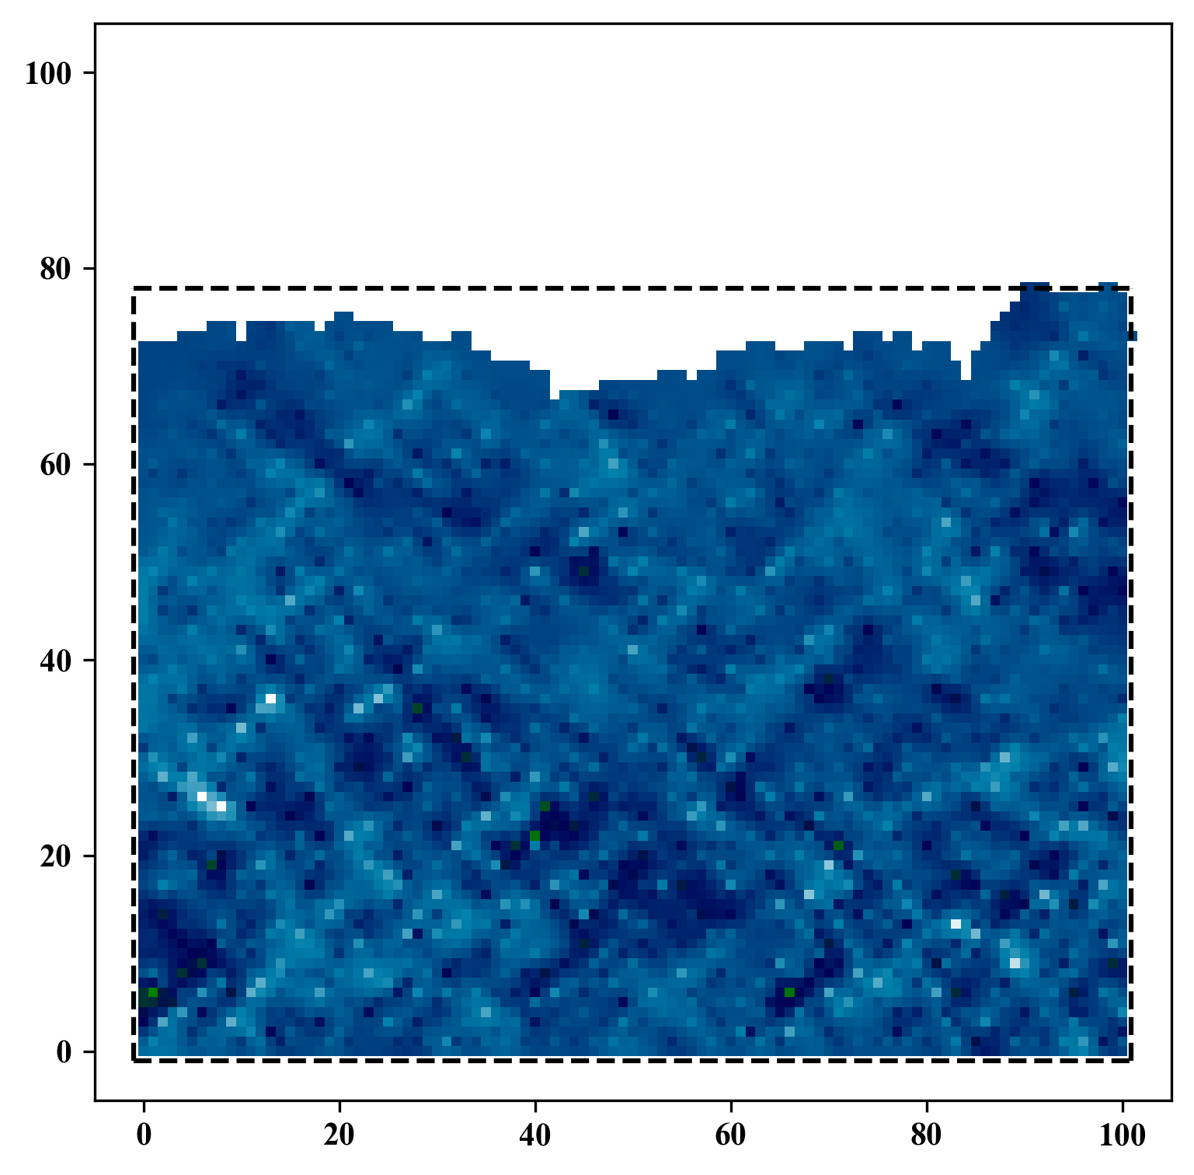
Spatial Interpolation
GitHub: https://github.com/jerryweihuajing/Post-Processing

Slide 20
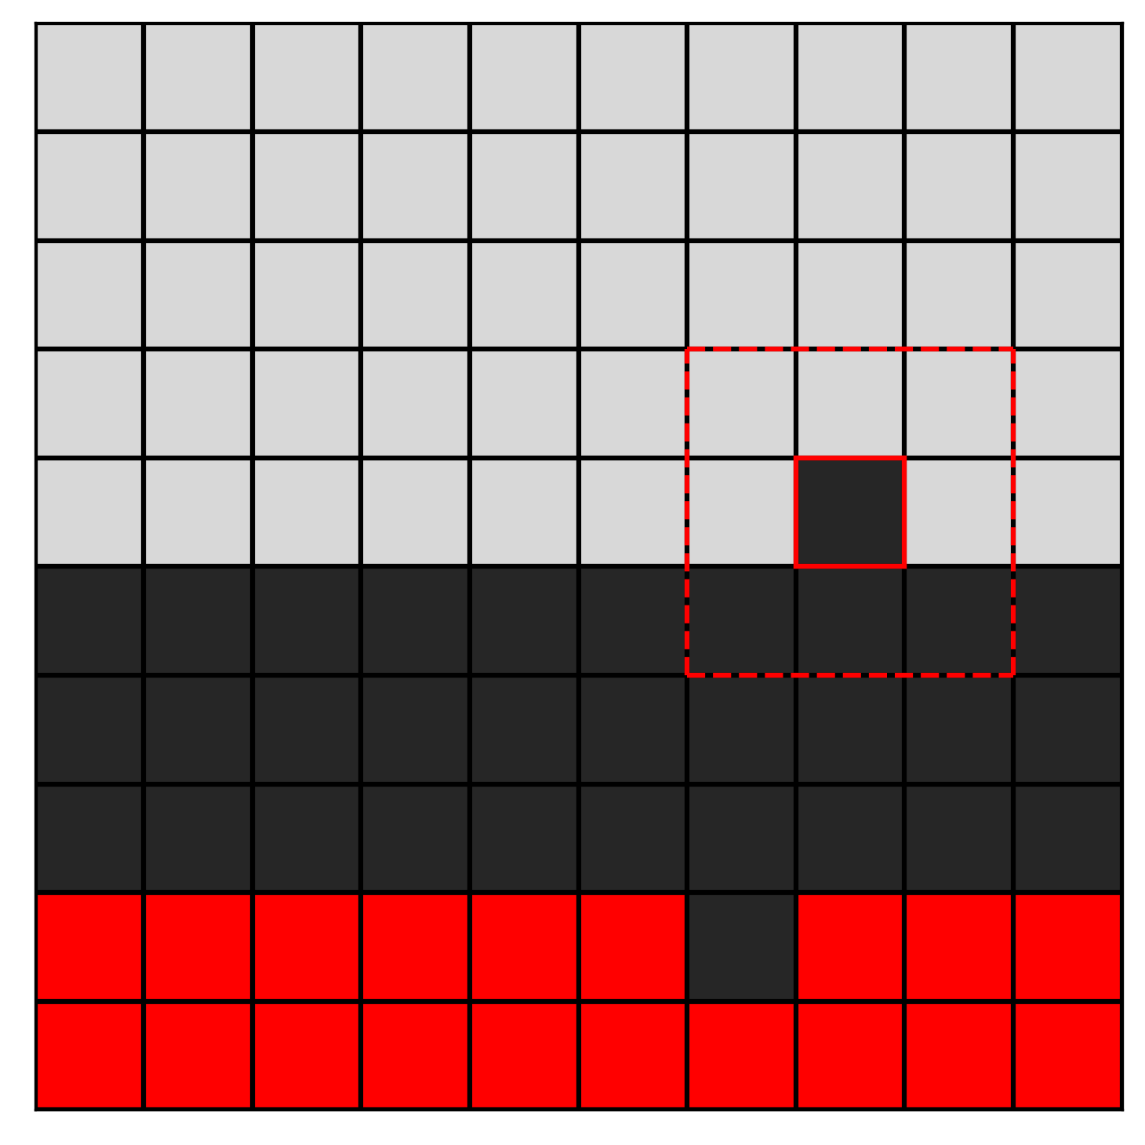
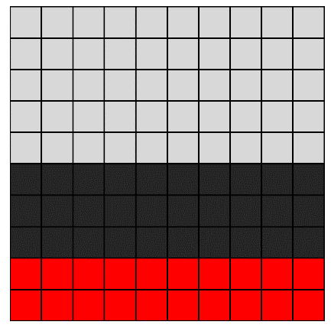
Gaussian Filtering
GitHub: https://github.com/jerryweihuajing/Post-Processing

Slide 21

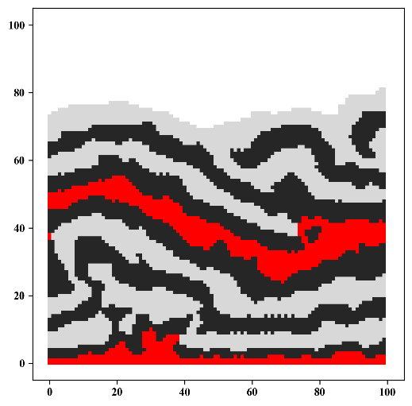
Gaussian Filtering
GitHub: https://github.com/jerryweihuajing/Post-Processing

Slide 22
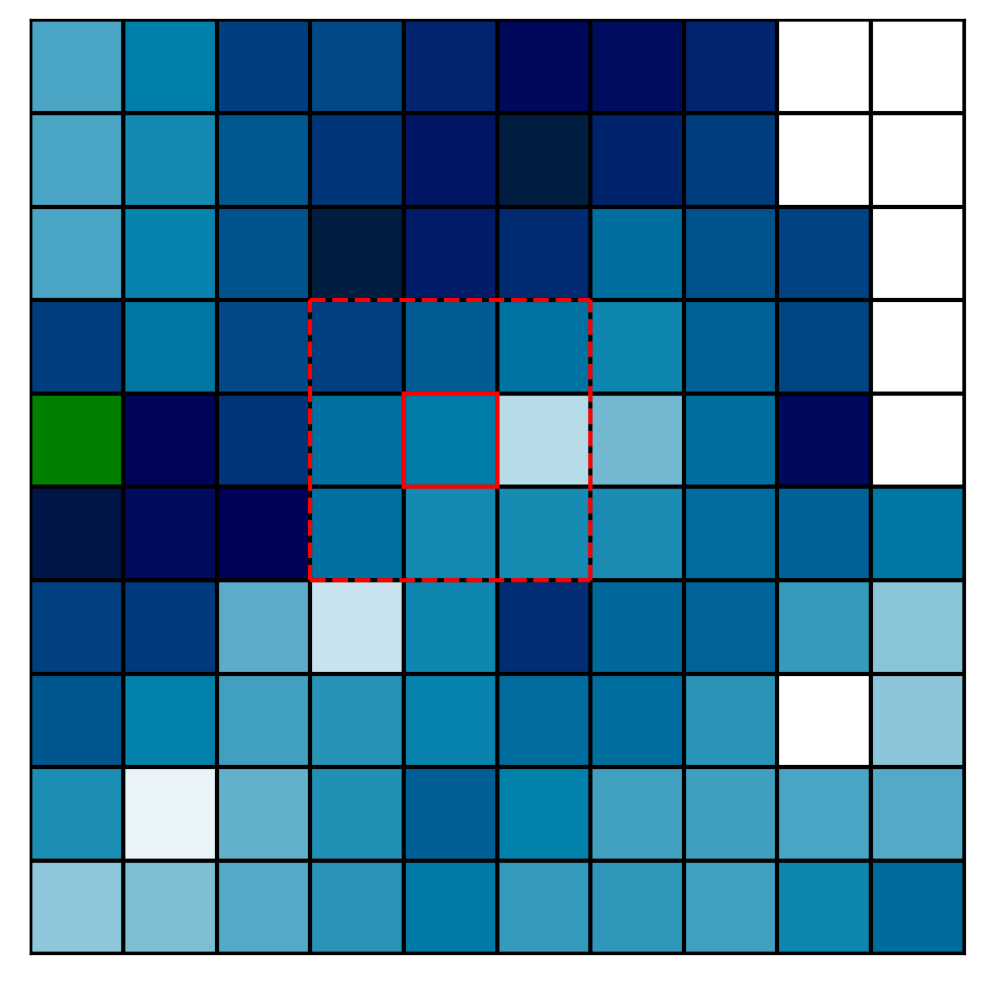
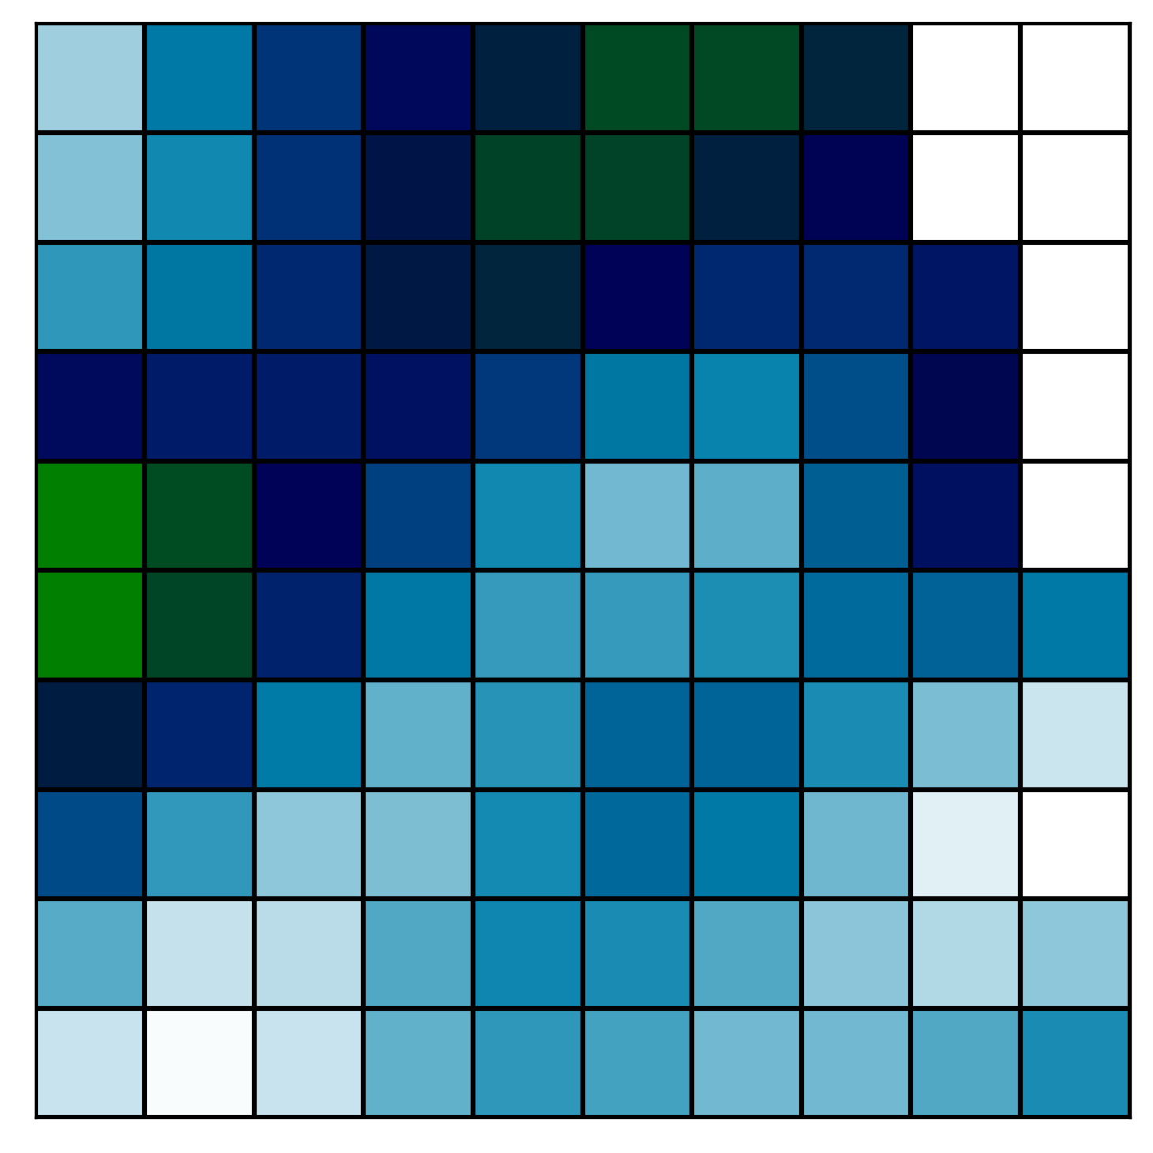
Gaussian Filtering
GitHub: https://github.com/jerryweihuajing/Post-Processing

Slide 23
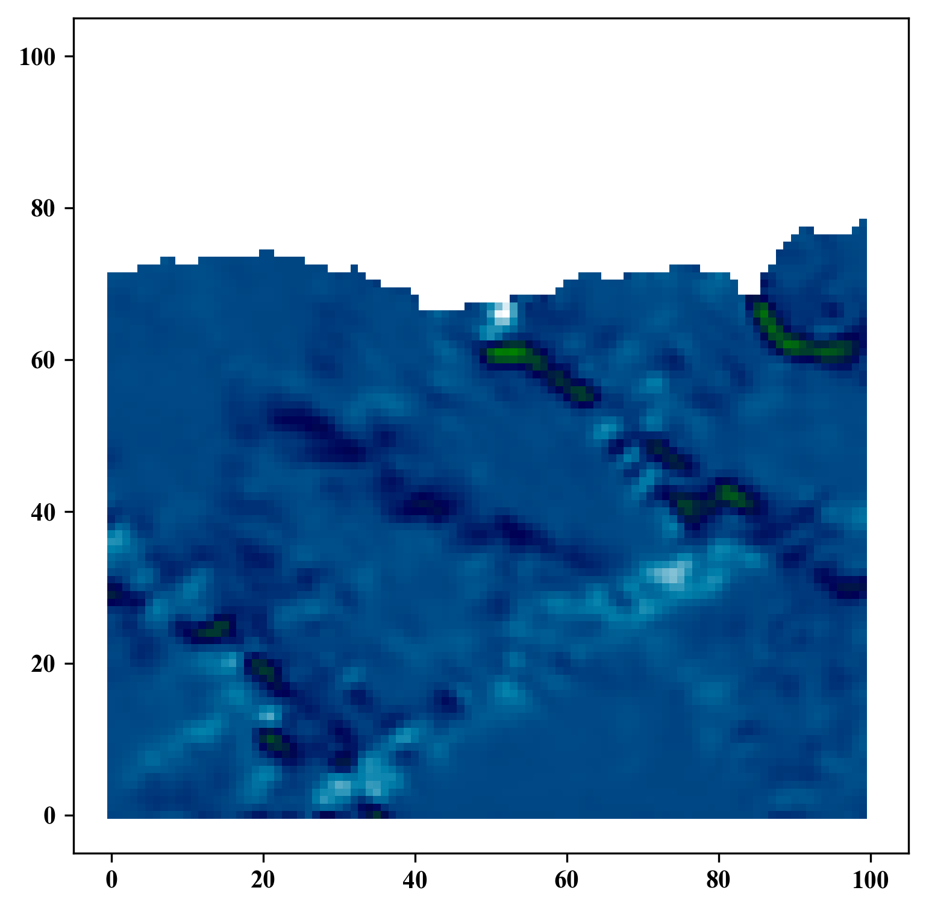
Gaussian Filtering
GitHub: https://github.com/jerryweihuajing/Post-Processing

Slide 24
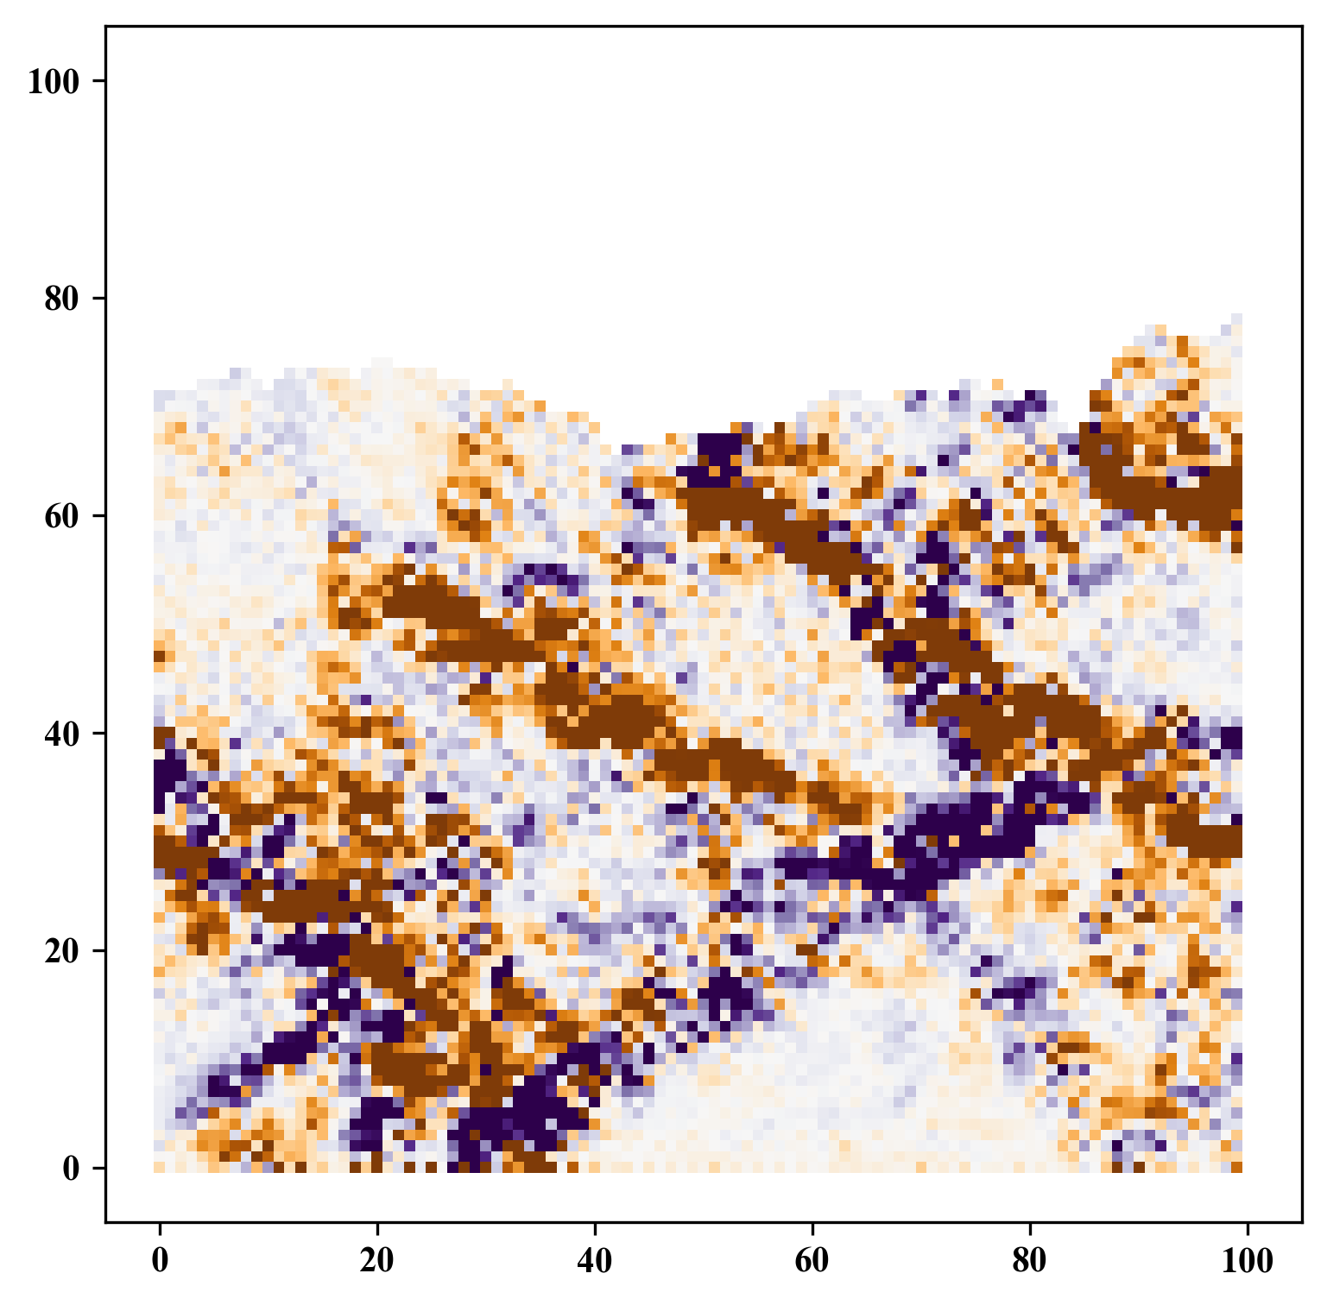
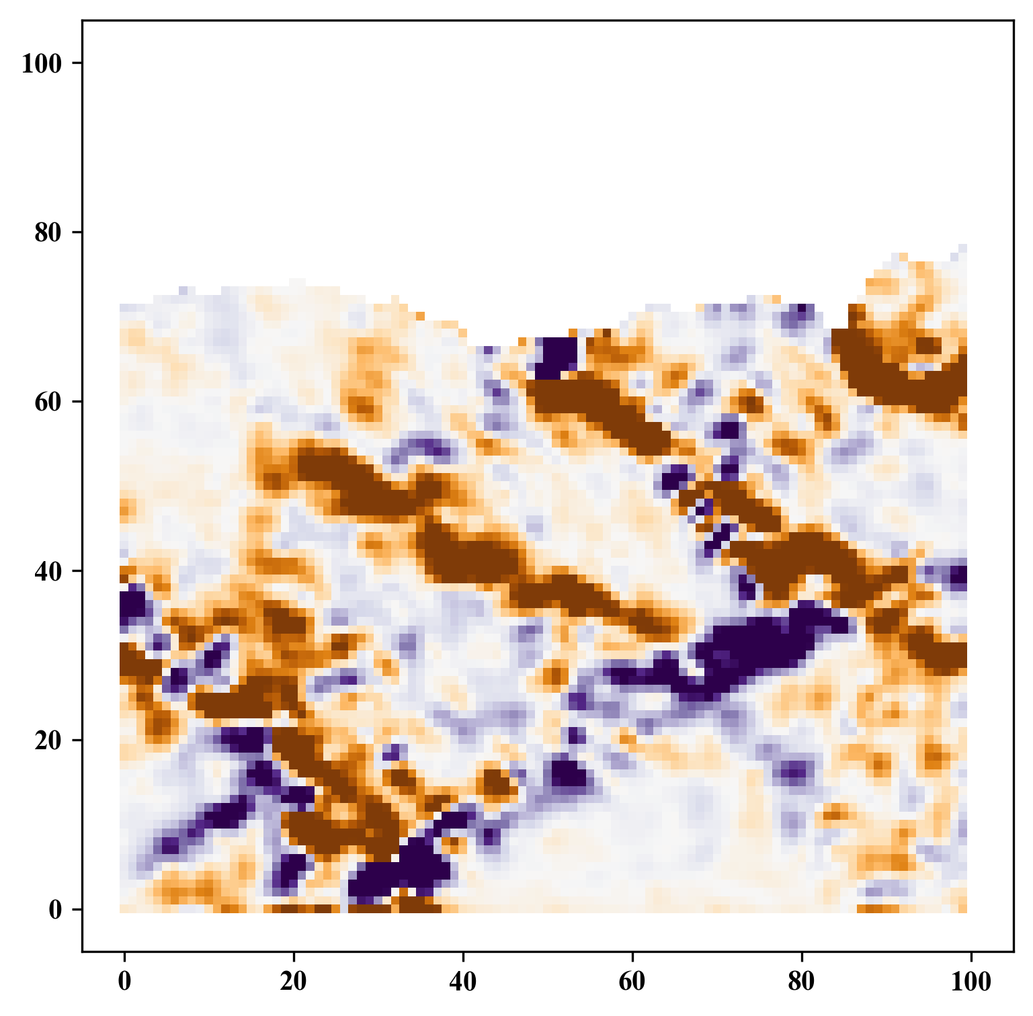
Gaussian Filtering
GitHub: https://github.com/jerryweihuajing/Post-Processing

Slide 25
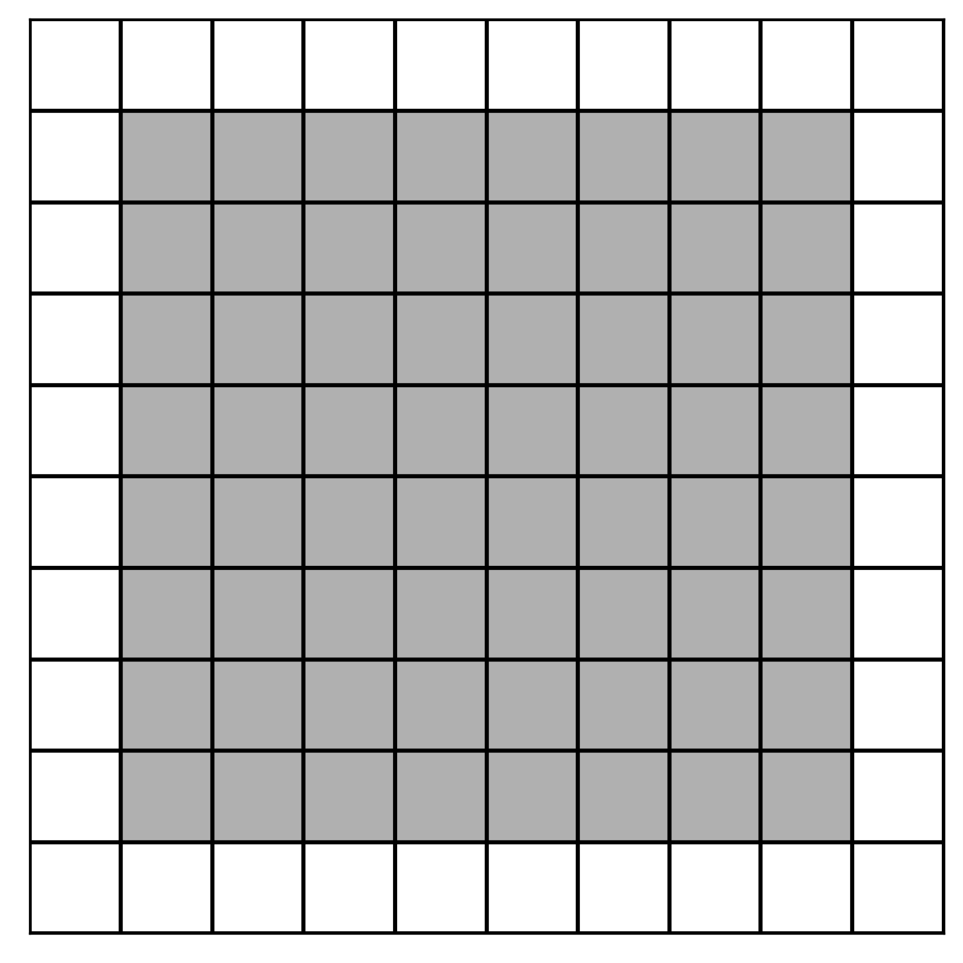
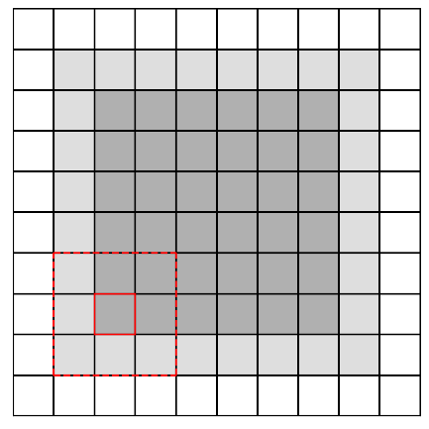
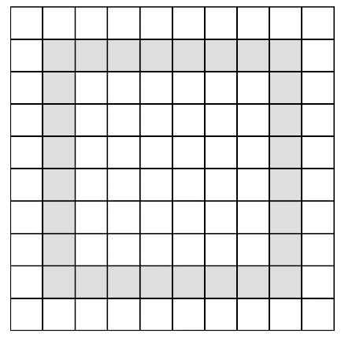
Boundary Extraction
GitHub: https://github.com/jerryweihuajing/Post-Processing

Slide 26
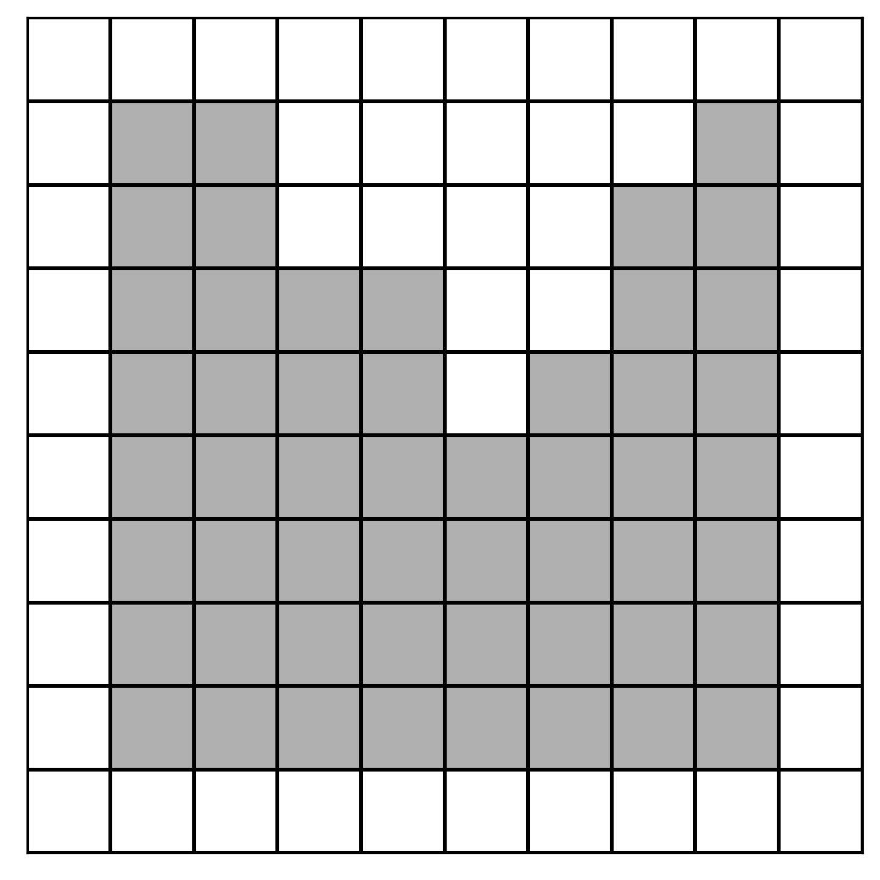
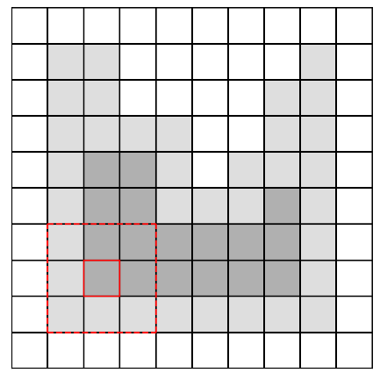
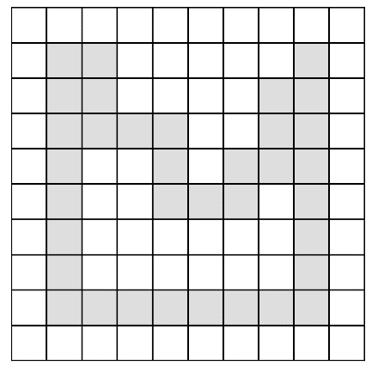
Boundary Extraction
GitHub: https://github.com/jerryweihuajing/Post-Processing

Slide 27
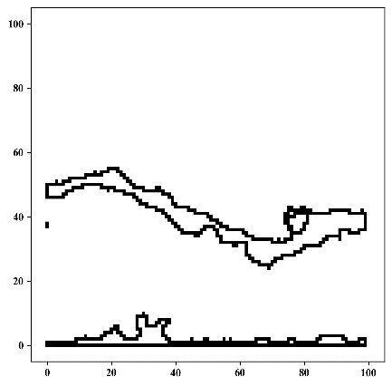
Boundary Extraction
GitHub: https://github.com/jerryweihuajing/Post-Processing

Slide 28
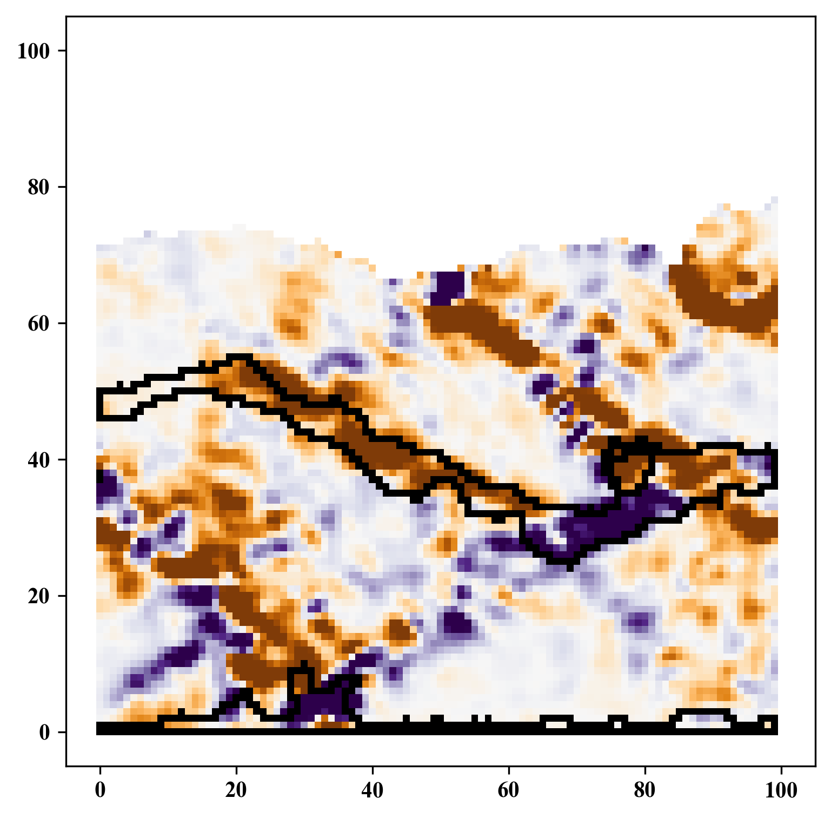
Boundary Extraction
GitHub: https://github.com/jerryweihuajing/Post-Processing

Slide 29
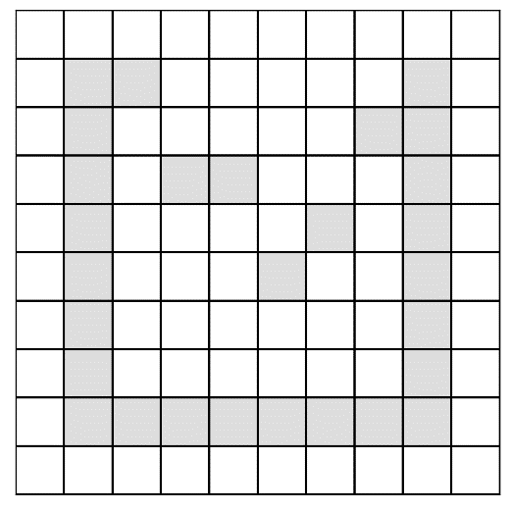
Outline Calculation
GitHub: https://github.com/jerryweihuajing/Post-Processing

Slide 30
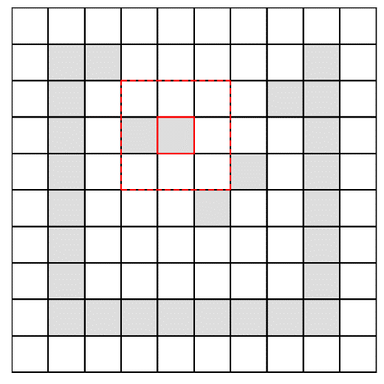
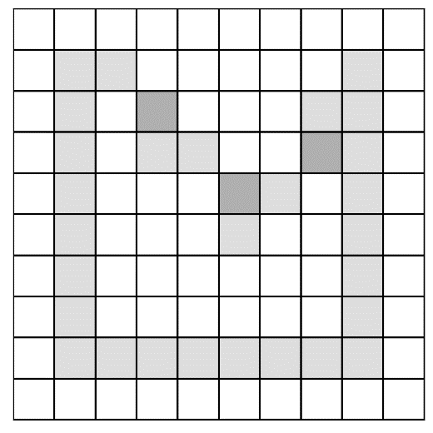
Outline Calculation
GitHub: https://github.com/jerryweihuajing/Post-Processing

Slide 31
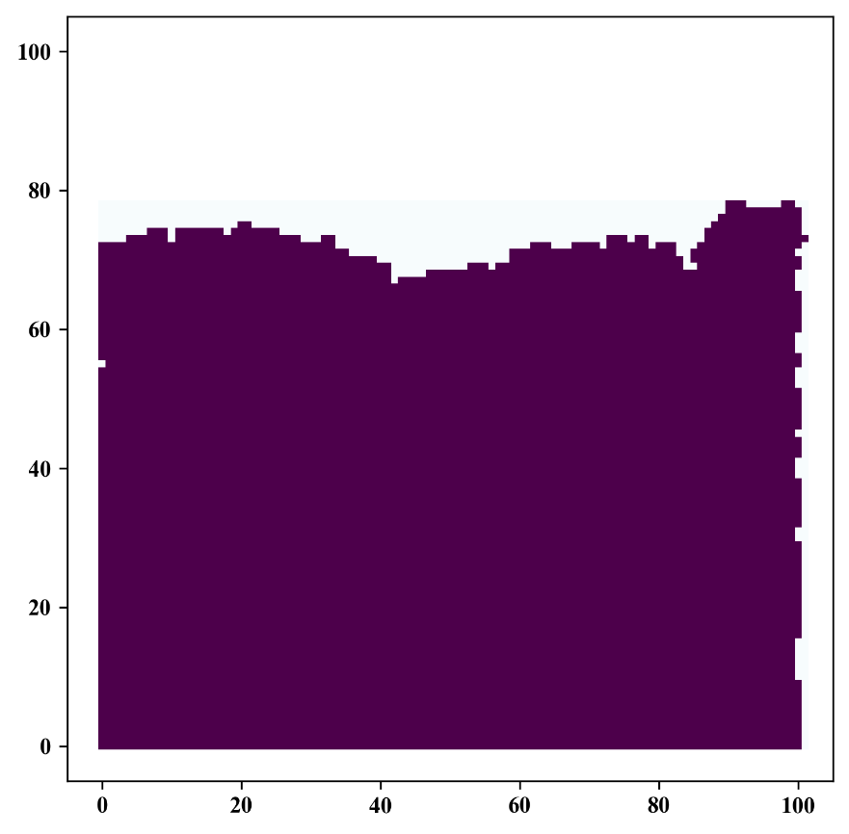


Outline Calculation
GitHub: https://github.com/jerryweihuajing/Post-Processing

Slide 32

Outline Calculation
GitHub: https://github.com/jerryweihuajing/Post-Processing

Slide 33
Outline
Introduction
Algorithm
Example
Experiment
Conclusion

Slide 34

Model

Slide 35

Structural Deformation

Slide 36


Mean Normal Stress & Maximal Shear Stress

Slide 37



Volumetric Strain

Slide 38



Distortional Strain

Slide 39



Velocity

Slide 40



X Displacement

Slide 41



Y Displacement

Slide 42



Velocity Gradient

Slide 43



X Displacement Gradient

Slide 44



X Displacement Gradient

Slide 45




Advantages of DEMpost

Slide 46





Advantages of DEMpost

Slide 47




Advantages of DEMpost

Slide 48
Outline
Introduction
Algorithm
Example
Experiment
Conclusion

Slide 49


Base

Slide 50


Salt Thickness

Slide 51


Salt Thickness

Slide 52




Salt Width

Slide 53




Salt(far away) Width

Slide 54




Salt Depth

Slide 55




Salt Offset

Slide 56




Fault Orientation

Slide 57




Fault Inclination(+)

Slide 58




Fault Inclination(-)

Slide 59




Fault Depth(+)

Slide 60




Fault Depth(-)

Slide 61


Fault Offset(+)

Slide 62


Fault Offset(+)

Slide 63


Fault Offset(-)

Slide 64


Fault Offset(-)

Slide 65




Fault Scale-from Bottom(+)

Slide 66




Fault Scale-from Bottom(-)

Slide 67




Fault Scale-from Surface(+)

Slide 68




Fault Scale-from Surface(-)

Slide 69
Conclusion

Slide 70
Acknowledgement
THANKS

